Slide 1

Search Driven Apps
with the Elastic Stack
Notes:
Joe Zack, dev, podcaster
Search driven apps, focus on Elastic
Define the problem
How Elastic solves it
Demonstrate 3 types of apps
Go do it!

Slide 2
The problem?
StackOverflow does 34M searches per day
Google servers 40k searches…per second
Amazon sells over 500M products
Splunk indexes 100’s of TB per day
Notes:
Search is a core tenet of the modern day internet experience.
Google obviously, but think about how important search is to other experiences: Cortana, Spotlight, Alexa
You can hardly use the telephone, listen to music, buy underwear, or even watch “tv” without some sort of search. Imagine explaining that to your grandparents grandparents!
But…we humans aren’t very good at it.
We type things wrong, and a lot of the time we don’t know the name of the thing!
Tons of data: 5B videos watched on YouTube every day: https://merchdope.com/youtube-statistics/
How are these services doing it?
https://ardorseo.com/blog/how-many-google-searches-per-day-2018/
https://www.scrapehero.com/many-products-amazon-sell-january-2018/
https://stackexchange.com/performance

Slide 3
The Elephant in the Room: RDBMS
Atomicity, Consistency, Isolation, Durability
Transactions
Mature
Advanced features like full text
Notes:
First up, lets address the elephant in the room
Relational databases are mature, robust solutions
They’re great at storing and retrieving data, and they’ve matured really well.
They’re really good at transactions
The standard argument that they don’t scale horizontally well, ”web scale”
Atomicity, Consistency, Isolation, Durability
Basic Availability, Soft State, Eventual Consistency

Slide 4
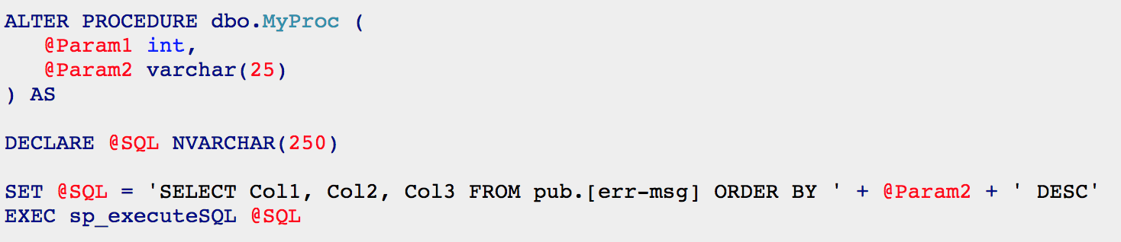
Dynamic queries though...
Notes:
RDBMS are not so good at complicated queries
ANSI SQL is really limited, and crusty, and once you get to a point – you end up having to create dynamic queries
String building, which is particularly annoying when you’re doing dynamic parameterization
Ever written code like this?
It starts out innocently enough, just a simple like search. Then you start searching other fields.
This is what it takes to sort by properties dynamically, can anyone tell me what’s wrong with this approach?
Sql injection
Dynamic “IN” clauses, One to many, temp tables, group by, dynamic columns, CTE, pivots
Query optimizers are not so good at executing dynamic sql either, they really want to compile their stored procedures and reuse the plan. They’re not optimized to deal with procs that run wildly different queries every time you run them.
Next thing you know you’re dynamically adding joins, and creating temp tables, group by, LIST_CONCAT, CTE, pivot, dynamic sorting, temp tables
You’ve got if statements for this and for that…and if you’ve got paging, and need to support multi-page actions…
You’ll bump into interesting edge cases – like the fact you can’t have procs that populate temp tables, calling procs that populate temp tables.

Slide 5
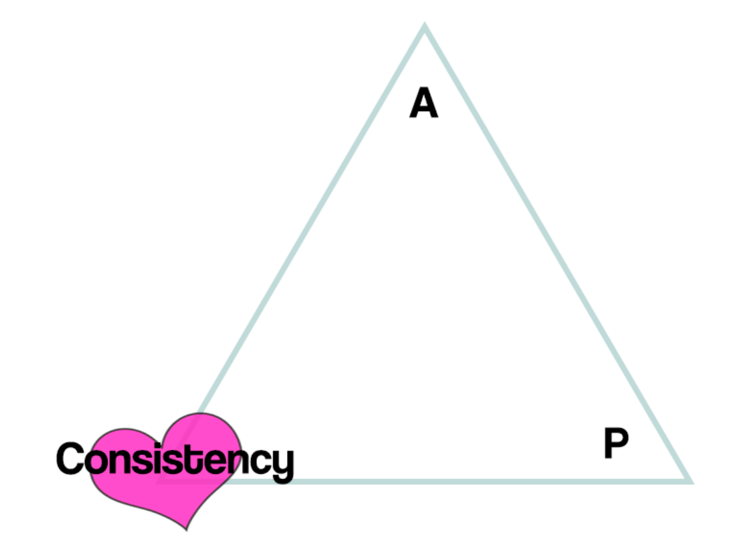
Relational DB
Don’t scale horizontally very well
Designed for ACID instead of BASE
Shredding is inefficient
Writing dynamic ANSI SQL is the pits
Notes:
Relational database aren’t optimized for searching
Atomicity, Consistency, Isolation, Durability
Basic Availability, Soft State, Eventual Consistency

Slide 6
When your query is still running after 2 minutes and you see your face reflected in the IDE

Slide 7
Here’s what I want…
REST API
Declarative Syntax
Wicked fast

Slide 8
Creating a Basic Search Engine
NoSql DB
Index everything
Map/Reduce
Declarative language
Notes:
Well… you just invented a search engine
You could roll your own thing
Or you could use a modern search engine that has taken that starting point and evolved it for 20 years
(Lucene released in 1999)

Slide 9
Inverted Index Search
Notes:
When I said “index everything”
Search engines make use of what is called, a inverted index.
Sounds like it might be a bit complicated, but really
We just take the important bits out of our data, store it in a hash table
The value in the hash is a vector of pointers back to our original data
Hashes are ruthlessly efficient at lookups, but they data you’re storing will end up taking up a lot more room than the size of the data
Inserts and updates aren’t so great either, simple example above the first sentence represents 8 inserts, potentially on different machines
Additionally, the size of the data is about double since every important word is stored again.
Thankfully the modern search engines are good about compressing the data, so things in practice end up being better than that.
Fox book example:
Encyclopedia
Book on Foxes

Slide 10
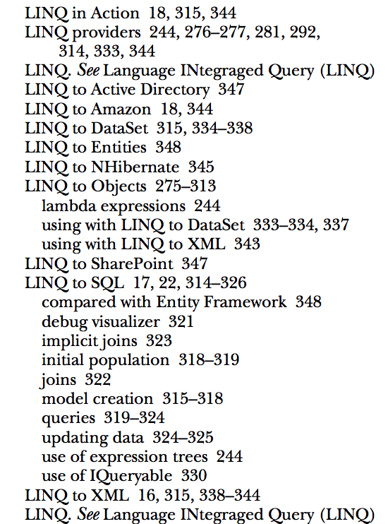
Inverted Index
Notes:
Now I’ve been saying ”Hash” table, because that’s a common programmer-y data structure
But search engines call it an index, because it’s a bit more specialized – but in practice it’s not that difference from an index in a book.
Remember those?

Slide 11
Inverted Index Search Engines
Inverted Index Database
Slow to Write, Fast to Read
NoSql before it was called NoSql
Scale Super Well
Wicked Fast Lookups
Support Complex Filters
Allow for easy scoring of data

Slide 12
English is complicated!
Stop words: “the”
Phrases
Synonym: PWA = “Progressive Web Apps”
Stemming: run, runs, ran, running
Fuzzy searching (typos)
Numeric stuff too
Notes:
Some other benefits of those 20 years of evolution

Slide 13
Search Vocab
Index
Shard
Keywordss
Terms

Slide 14
Elasticsearch vs….
Lucene
Solr
Cloud
Azure Search
AWS Cloudsearch
AWS ES
Notes:
Most support a basic Lucene style syntax, and more are built on Lucene
I won’t get too into the weeds on how that works, but the important bit is that Elasticsearch is king of the hill right now
2 reasons:
1: Really nice REST api, for building advanced filters
2. It's an ecosytem

Slide 15
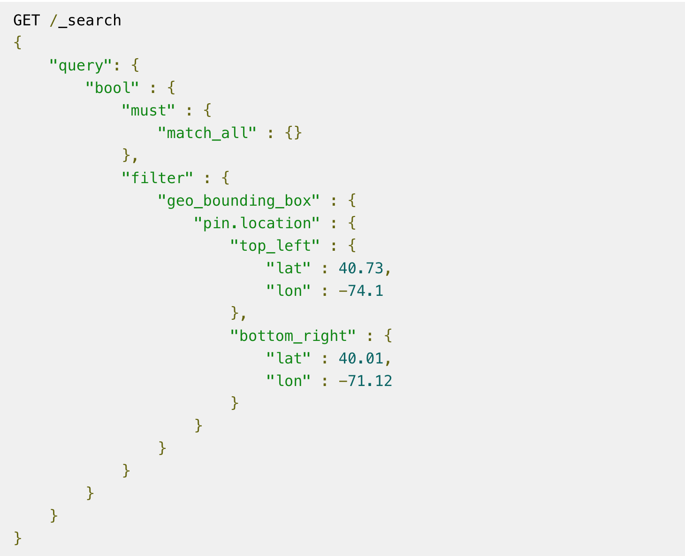
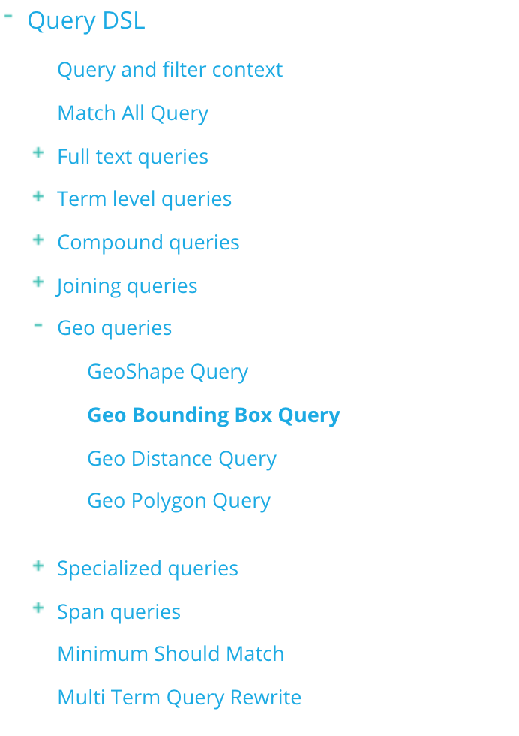
Reason #1: Advanced JSON API
Notes:
Reason #1: Query DSL

Slide 16
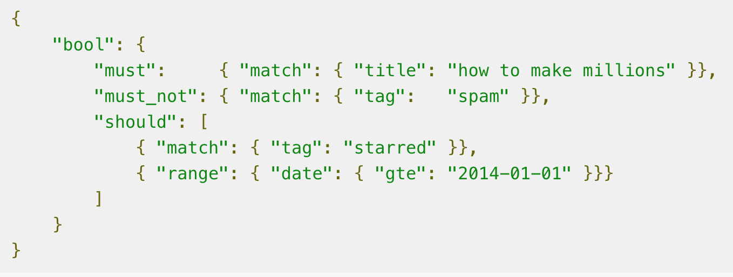
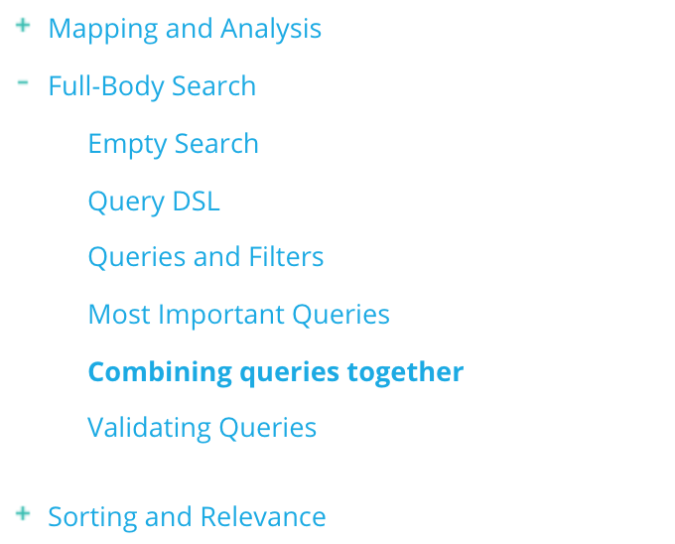
It’s Complicated…

Slide 17







Elastic Stack
Notes:
Reason #2 The Elastic Stack
A host of products that are designed to work with and extend Elasticsearch

Slide 18
What can I build?
Free text search
Aggregation and Filtering
Logger/APM

Slide 19
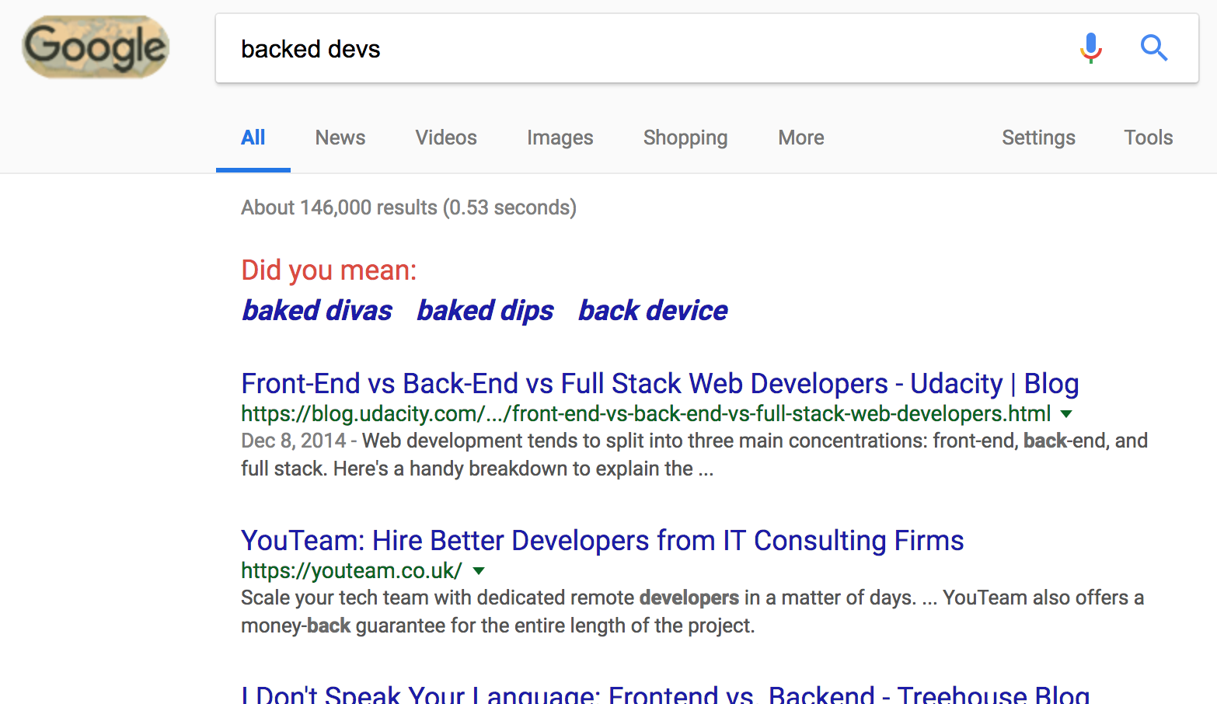
Full Text Searching

Slide 20




Aggregations
Notes:
80,000 for “camera’

Slide 21
Application Performance Management (APM)
Notes:
Splunk DataDog
Difference here is
Windows 2012
Python 2.7

Slide 22
This is how we do
Spin up the architecture in Docker
Create an index
Populate the data
Write some queries in Kibana
Make an App

Slide 23
Logstash loads data
Python/Flask for users
APM X-Pack Plugin for monitoring
Kibana for Administration Elasticsearch for everything

Slide 24
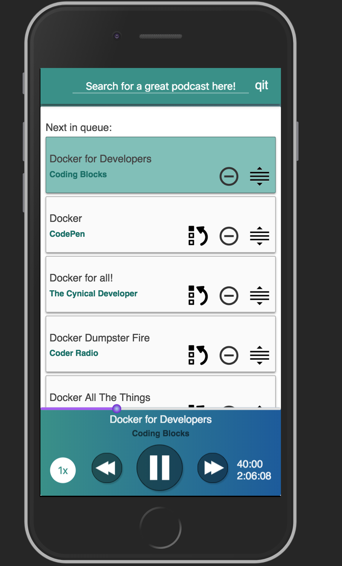
QIT.cloud
Notes:
Indexes about 7,000 episodes
Query it in about 0 seconds, rounded up
Search engine allows us to focus on UX

Slide 25
Search Driven Apps
with the Elastic Stack
Notes:
ElasticSearch is a highly scalable and feature-rich search engine that makes certain types of problems very easy to solve. I will show you how Elasticsearch approaches these problems and then demonstrate 3 different types apps that make good use of this approach.

Slide 26

Like this talk? Check out the show!
Joe Zack
@codingblocks
Notes:
We speak with 10’s of thousands of programmers every month who want to get better
Take lessons from modern research and other fields and apply them to programming as yet another way to learn

